Slide 1
Building Organizational Capacity to Achieve MNH Goals
AlignMNH Opening Forum: Networking Session
Jim Ricca and Kavya Ghai, MOMENTUM Country and Global Leadership
April 20, 2021

Slide 2
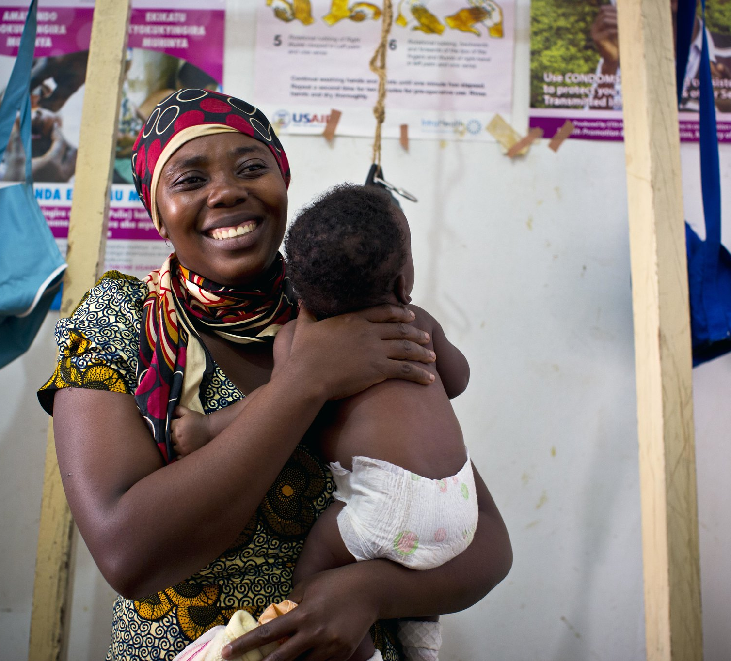
INTRODUCTION & PROJECT APPROACH:
MOMENTUM Country and Global Leadership

Slide 3

MOMENTUM Country and Global Leadership
MOMENTUM Country and Global Leadership engages in global initiatives and provides technical and capacity development assistance (TCDA) to country partners to apply evidence and best practices to accelerate progress toward sustainable improvements in the health of women and children. We support country governments to expand and enable partnerships with a wide range of health and non-health actors, including public, private, faith-based, civil society and youth-led entities.
Notes:
Our TCDA approach focuses on accompanying country stakeholders with an emphasis on partnerships, mentoring, mutual accountability, co-investment of resources, program technical rigor and adaptive management to accelerate delivery of high-quality, evidence based interventions at scale to reduce maternal, newborn and child mortality and morbidity.

Slide 4
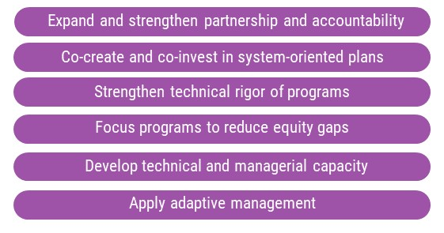
Elements of Technical and Capacity Development Assistance in Countries
Accelerators to Action
We use systems thinking to address problems holistically
We place emphasis on the drivers of behaviors, addressing those that accelerate and inhibit change
We engage country leaders as thought partners to guide global policy development
We prioritize catalytic innovations and lead a learning agenda
We apply six accelerators to help countries achieve progress throughout their programming cycles and toward sustainably improved health outcomes

Slide 5
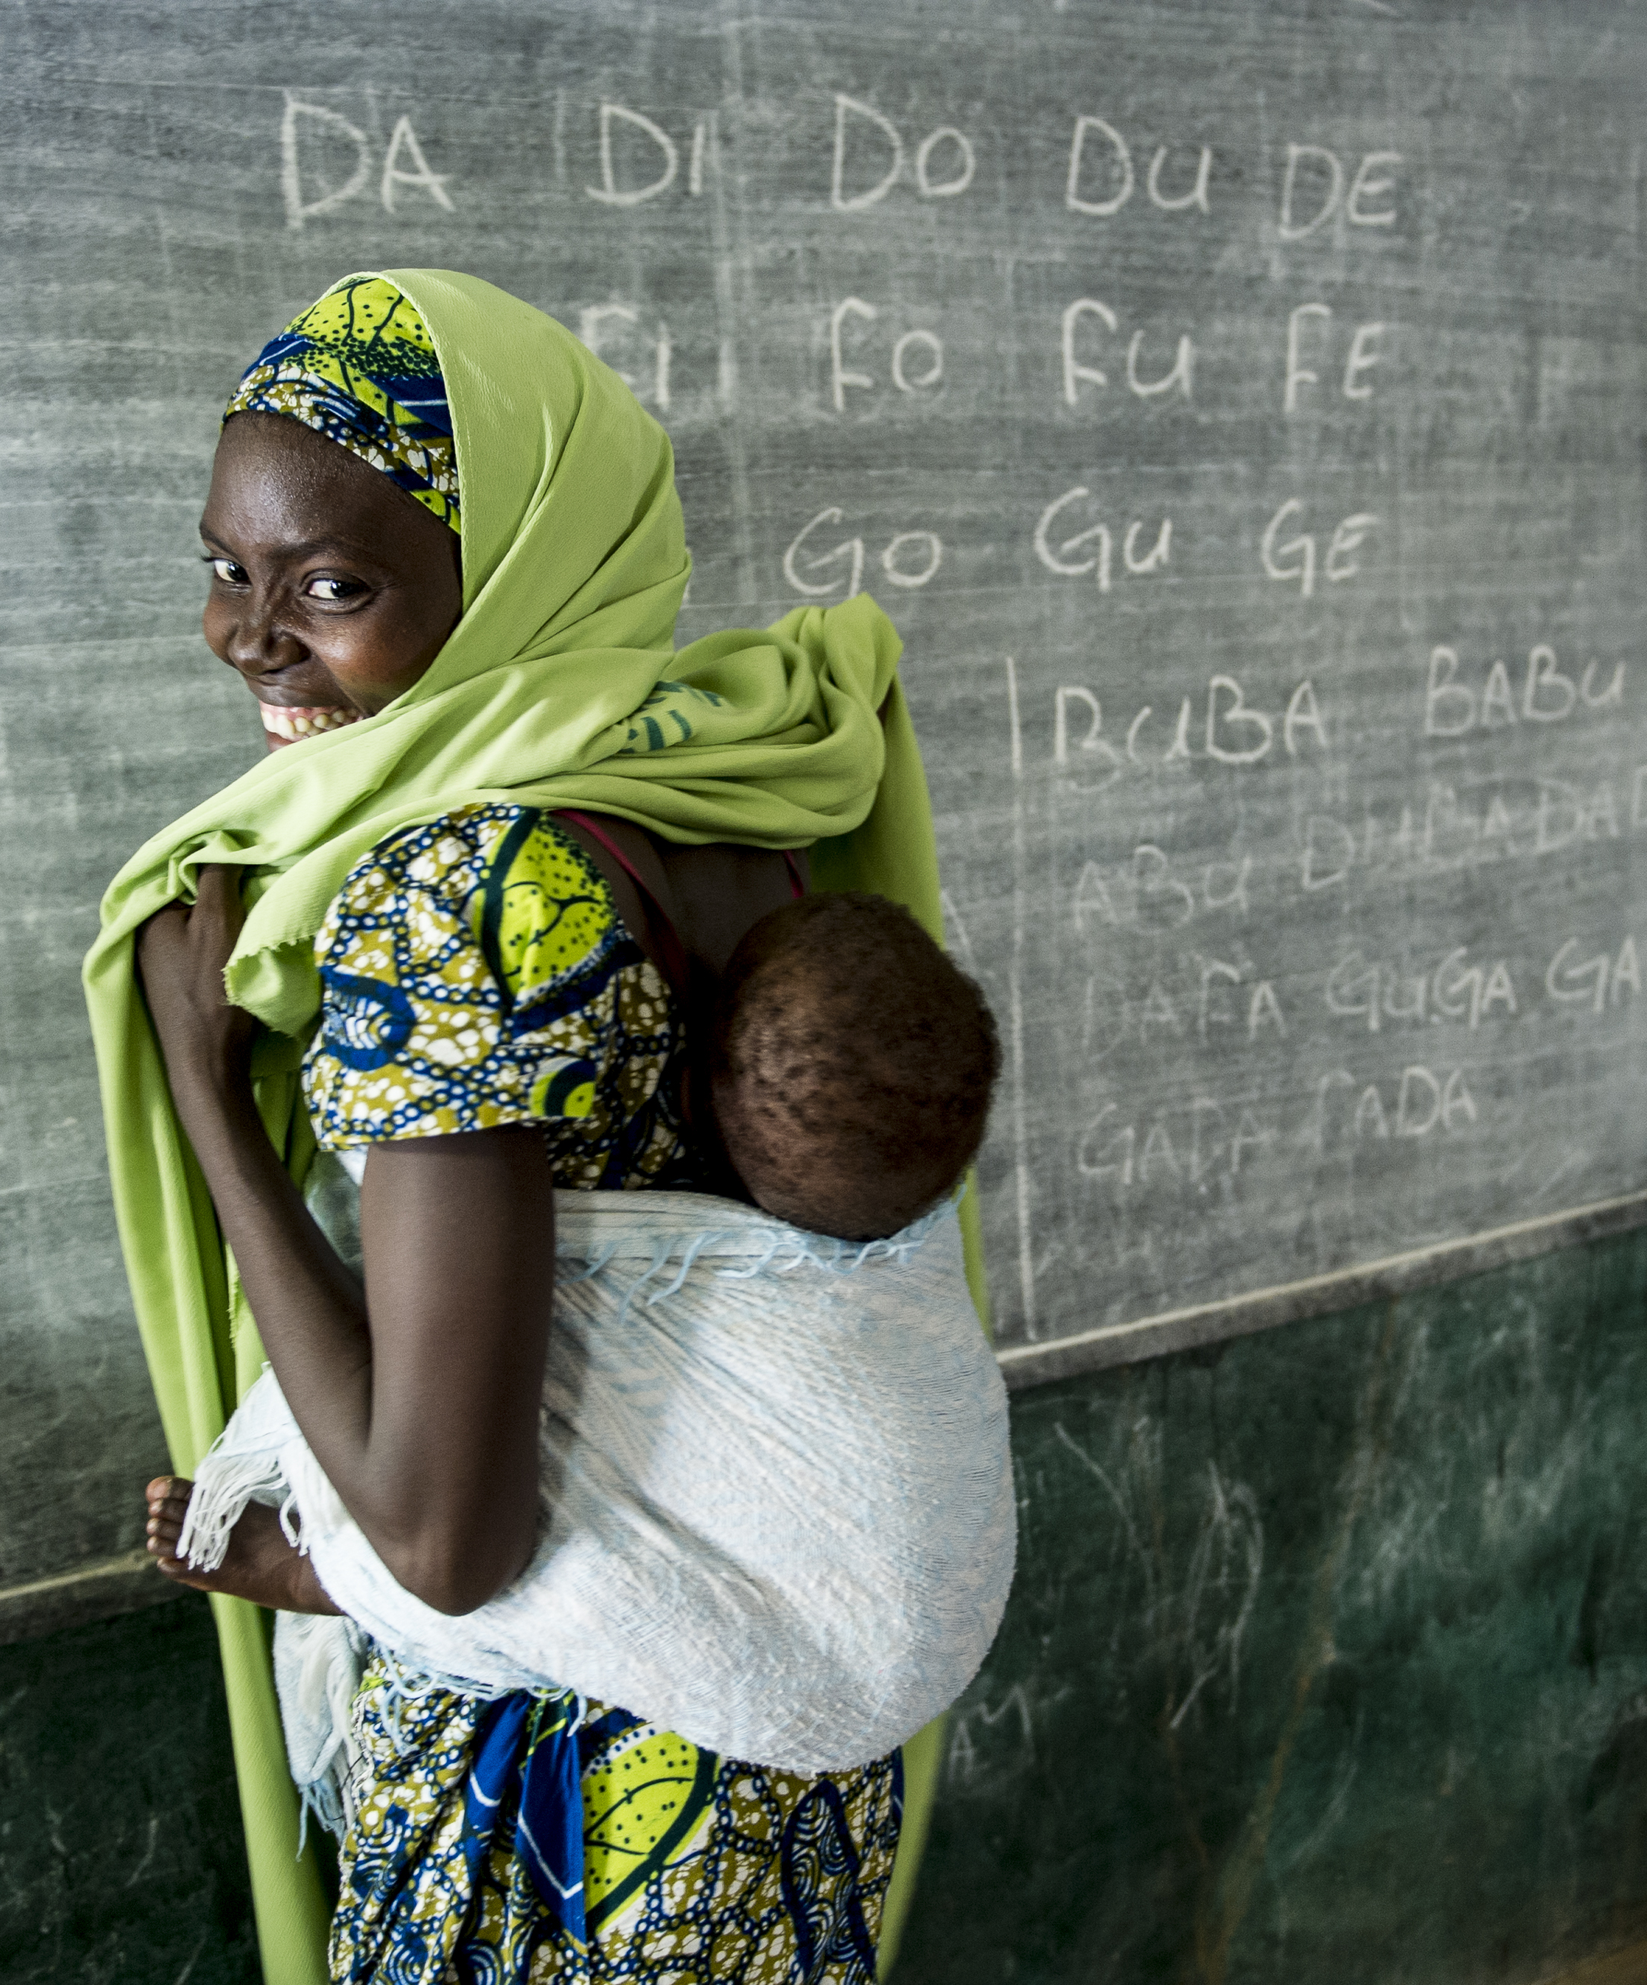
Global Leadership
We engage in global initiatives and contribute to the development and updating of global guidance for MNCH/FP/RH services
We promote representation of country voices and experience in global initiatives and guidelines.
We work to elevate country voices in global and regional fora
  Leverage our connections to key global groups to promote country voices
  Make current methods of country engagement more responsive to country needs and realities
  Coach country-level participants on how best to participate and inform policy dialogue
  Advocate to “flatten” the hierarchy of the global policy architecture
We support countries to operationalize and contextualize global strategies and guidance based on country needs and priorities

Slide 6






































MOMENTUM Country and Global Leadership — Current Activities
F = Field funding
C = Country work with core funds
Bangladesh
Côte d’Ivoire
Indonesia
Sierra Leone
Cameroon
India
Malawi
Nigeria
Rwanda
Tanzania
Uganda
Ghana
Zambia
MATERNAL AND NEWBORN HEALTH
CHILD HEALTH
C
F
F/C
F
F
F
F
C
C
F/C
C
FP/RH
IMMUNIZATION
WASH/IPC
NUTRITION YOUTH HEALTH
GENDER QUALITY IMPROVEMENT
DIGITAL HEALTH COVID-19 RESPONSE COMMUNITY HEALTH
C
F/C
F
F/C
F/C
F
F
C
C
C
F/C
C
F/C
C
F
F/C
F/C
F
F
F/C
F/C
C
F
F
F
F/C
C
F
F
C
C
F
F
F/C
Journey to Self-Reliance
F
C
F/C
LOCAL ORG CAPACITY BUILDING
C
F/C
F
F
F/C
C
F/C
C
PRIVATE SECTOR PARTNERSHIPS
F
F/C
HEALTH WORKER CAPACITY
DEVELOPMENT
POLICY AND ADVOCACY
F
F
F
F/C
F
C
C
F/C
F
F/C
C
C

Slide 7
Reaching countries with evidence & high impact interventions

Slide 8
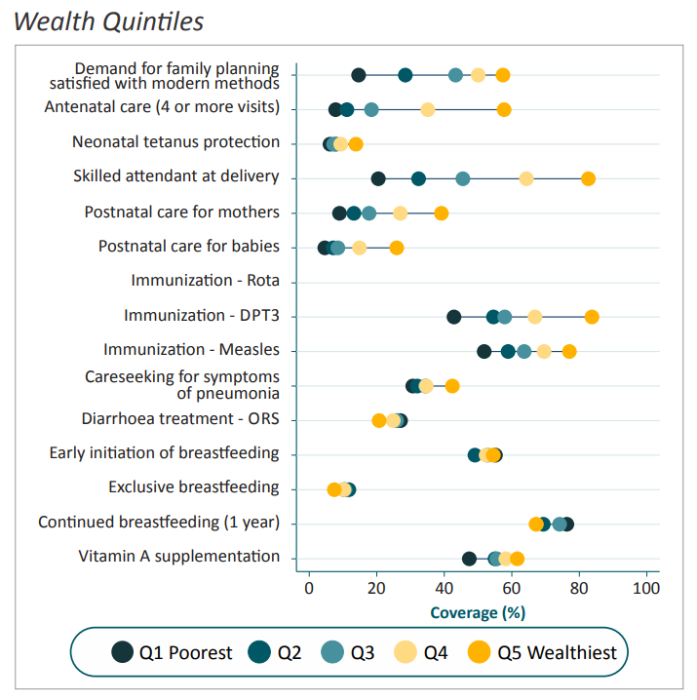
Interventions often do not reach those in greatest need
Equity in Yemen by Wealth Quintile
Source: Countdown 2030 profile (DHS 2013)
Coverage of care is low – and lower for the poor
Progress in skilled care coverage is too slow and should be accelerated
Cost-effective, simple approaches at the family and community level can save many lives

Slide 9
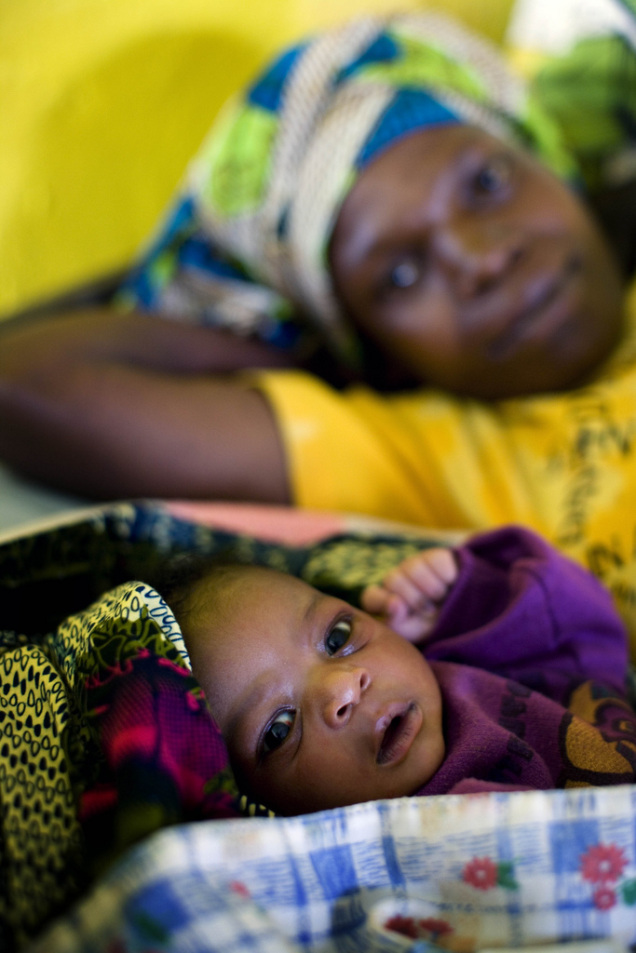
When mothers die…
Families fall apart and communities suffer.
Children who lose their mothers are five times more likely to die in infancy than those who do not.
Photo: Kate Holt/Jhpiego
Notes:
Difficulty managing the household: Fathers and surviving children are often hard-pressed to take on the myriad tasks performed by one woman.
Increased child mortality among children whose mothers had died. The research found that newborns whose mothers die in childbirth are far less likely to reach their first birthday than those whose mothers do not die, or who die from other causes.
Child marriage: For many girls, the only viable options that remained were early marriage and early motherhood.
Decreased household income: Mothers are not only caregivers at home, but contribute substantially to household income.

Slide 10
Maternal Mortality is Preventable: Evidence-Based Interventions
Iron Supplements, Intermittent Treatment for Malaria and Antiretrovirals for HIV
AMTSL, Oxytocin, Bimanual Compression, manual removal of placenta, blood transfusion
Magnesium Sulfate
Antihypertensives
Antibiotics, Tetanus Toxoid, Immunization
Blood thinners
Partogram, C section
Family planning and postabortion care
Notes:
low-molecular weight heparin

Slide 11
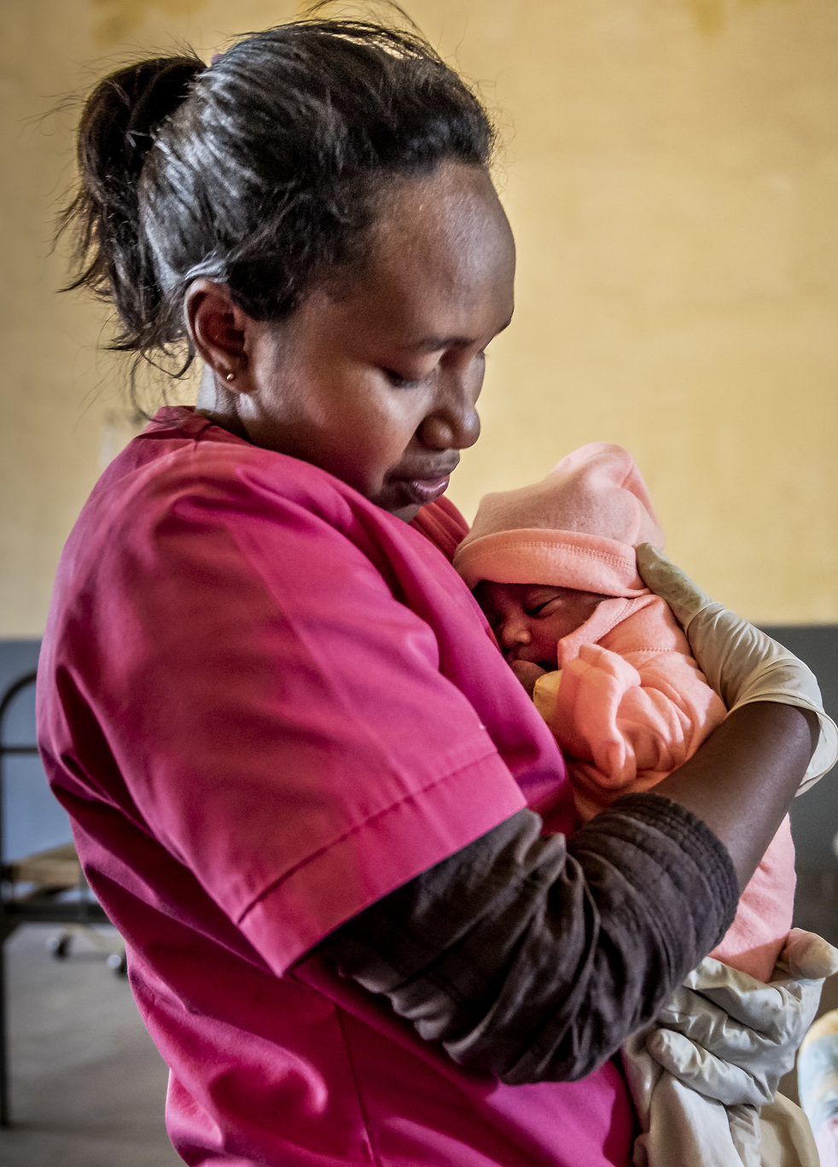
Program Solutions: Newborn Health
Essential newborn care, including breastfeeding
Low birth weight/pre-term birth prevention and management/Kangaroo Mother Care
Newborn resuscitation/ Helping Babies Breathe
Management of newborn sepsis
Cord care with chlorhexidine
Photo by: Kate Holt/MCSP

Slide 12

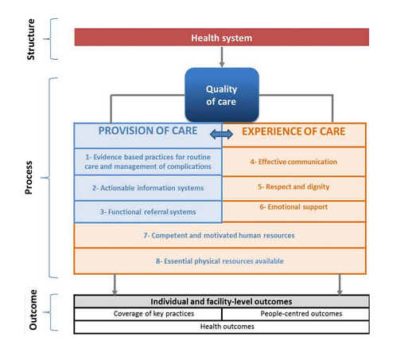
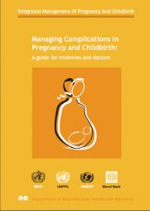

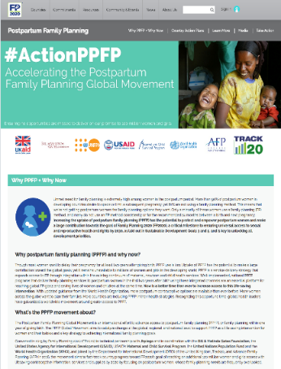

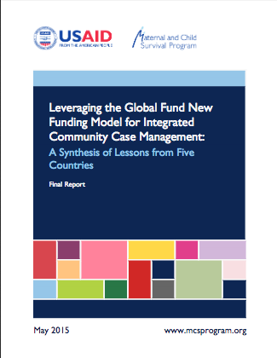
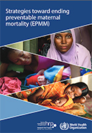
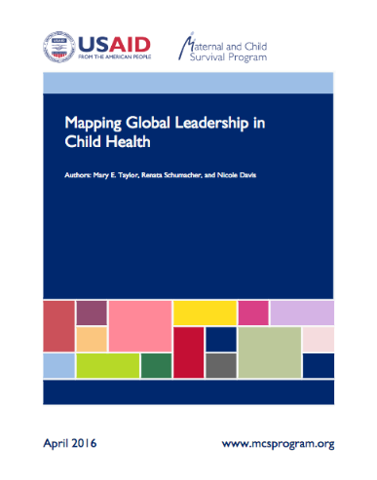

High Impact Interventions
Notes:
Our value add as a global program is to bring the country perspective to the global discourse and vice versa, given the expansive footprint we have across the world. We also promote learning and sharing of experiences from one country to others- south-to-south learning--across countries and regions.

Slide 13
Supporting countries to access to latest MNCH/FP evidence
MOMENTUM Country and Global Leadership works with AlignMNH to support country level engagement around MNH
We engage with national MNH technical working groups and stakeholders to plan, course correct, and drive action, powered by data.
We facilitate opportunities for multidirectional learning and sharing of evidence and experience. We work in partnership to prioritize ways to address entrenched obstacles and gaps in reaching MNH milestones and goals.
We drive country-level, multisectoral technical advocacy for emerging evidence in MNH care and practices.
We actively engage technical communities of practice and technical working groups to hear latest evidence and share implementation experience
Male Engagement Task Force
Maternal, Infant, and Young Child Nutrition-Family Planning-Immunization (MIYCN-FP-Immunization)
Post-Abortion Care (PAC) Connection
Postpartum Hemmorhage COP
Method Choice CoP
SBC for service delivery
AYRH COP
YouthPower COPs
Early Childhood Development (ECDAN)
Small and Sick Newborn (SSNB) CoP
Pharmacies and Drug Shops Working Group

Slide 14
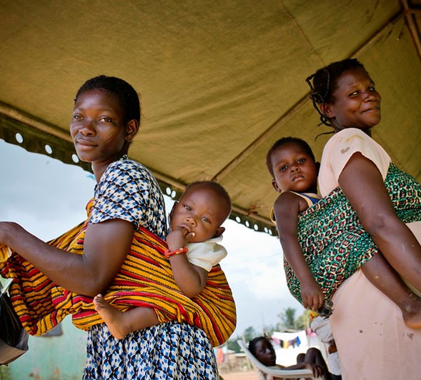
PROGRAM SOLUTION:
Organizational Capacity Development
Notes:
Introduce ITOCA tool

Slide 15
Capacity Development
A continuous process that fosters the abilities and agency of individuals, organizations, systems and communities to achieve their goals and contribute towards positive social change.
Theory of Change:
IF local organizations, networks, and systems become stronger with better internal policies, skills, procedures and practices;
THEN they will improve their external performance
Which LEADS TO greater impact (on health, the environment, livelihoods) in their target communities.
OUTPUTS
Change in internal systems, skills, policies
OUTCOMES
Improved external performance
IMPACT
Improved health, environment, livelihoods in the communities served
ITOCA
OPI
Impact Assessments
Notes:
Capacity development is one of our core approaches, and at Pact we define it as a continuous process that fosters the abilities and agency of individuals, organizations, systems and communities to achieve their goals and contribute towards positive social change.
Our capacity development theory of change is that when an organization becomes strong they improve their performance and thus have a greater impact in the communities they serve.
Capacity development is done with the community in mind. Thus, your organization isn’t developing internal systems just to have better systems, your organization wants to develop capacity to make an impact.
Theory of change and assessment tools

Slide 16
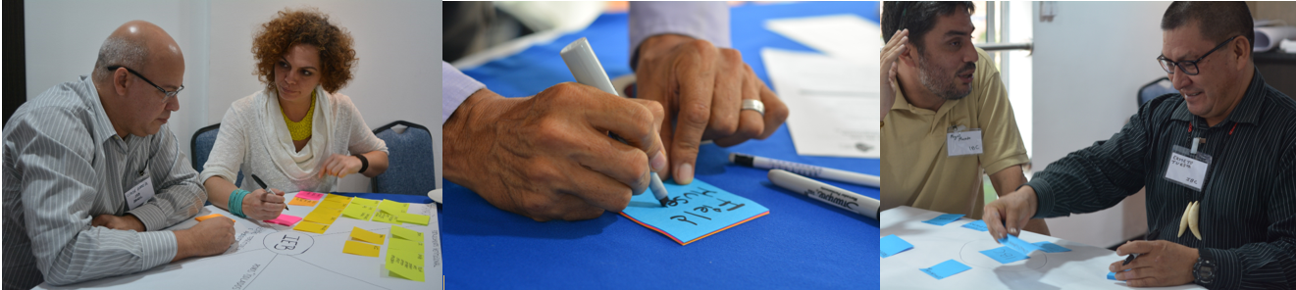
Purpose of the Integrated Technical and Organizational Capacity Assessment (ITOCA)
Tool and facilitated process designed for organizations to collaboratively:
  Identify strengths and weaknesses and capacity development needs
  Plan support needed by the partner
  Monitor changes in organizational capacity through implementation of Change Action Plans (CAPs) and re-assessment.

Slide 17
ITOCA approach
ITOCA and OPI
baseline
CAP Development and Implementation
Annual Re-assessment
Training, Coaching and Mentoring
Peer Exchange
Facilitated Assessments and Capacity Development Planning
Knowledge Management
Consultancy Services
Capacity Development Marketplace
ONE TEAM APPROACH

Slide 18
MOMENTUM Country and Global Leaderhip ITOCA Capacity Areas
The tool consists of several calibrated indicators under each capacity area. Each indicator has four levels known as statements of excellence, which participants score following a facilitated discussion on the capacity area
Organizational Areas (recommended to do all):
Governance and Legal Structure
Program Planning & Management
Financial Management
Procurement & Agreement Management
Human Resources Management
Strategic Information
Partnerships & Collaboration
Sustainability
Gender Integration
Technical Areas (chosen based on organization’s focus):
Maternal and Newborn Health
Family Planning
Sexual and Reproductive Health
Sexually Based Violence
Youth Health
WASH and IPC
Nutrition
Gender Transformative Programming
* Standards for Youth-led organizations are included in the above capacity areas
Notes:
Calibrated to 4 levels
Developed with technical área leads
Annexes have screenshots of tool + CAP

Slide 19
MNH Indicators in the ITOCA tool
Goals and measurable objectives
Equity, availability, accessibility, and acceptability of MNH care
Quality MNH care
Respectful maternity care
Culturally appropriate care
Family-centered care approach
Capacity development
Promotion of "normal“
Evidence-based care
Continuity of care from pregnancy through the postnatal period (woman/newborn)
Collaboration between cadres
Integration with other services
Perinatal networks
Learning collaboratives
Screening for gender-based violence (GBV)
Maternal mental healthcare
Care for tobacco/substance use
Adolescent care
Notes:
Calibrated to 4 levels
Developed with technical área leads – WHO resources

Slide 20
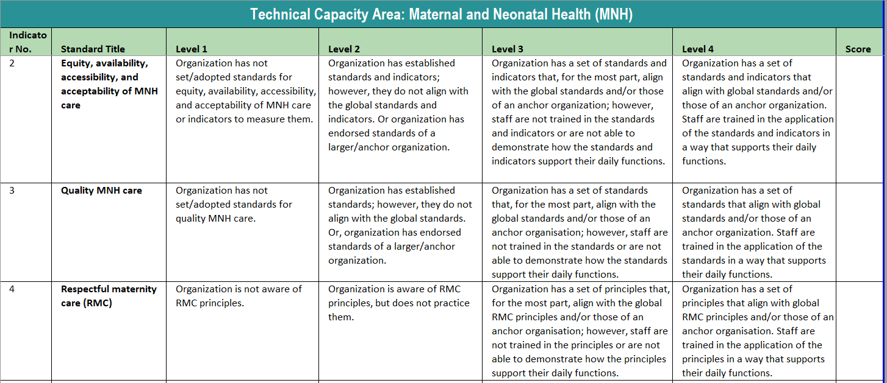
Sample scoring sheet for MNH

Slide 21
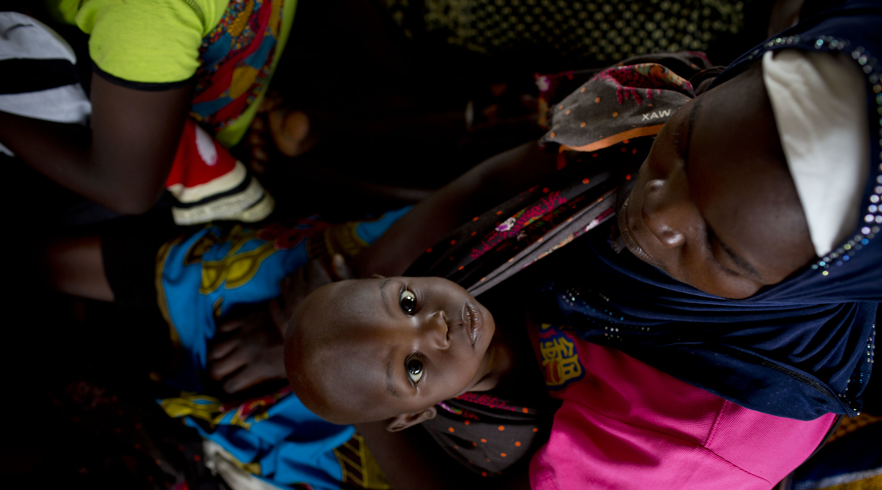
Questions?
For more information please visit:
www.usaidmometum.org

